Slide 1
Goal
To estimate and compare growth rates of functions
Ignore constant factors of growth

Slide 2
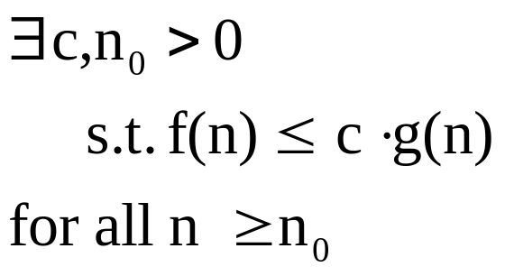
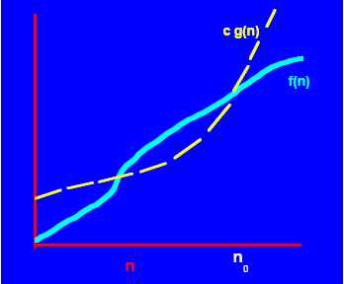
Example of f(n) is O(g(n))

Slide 3
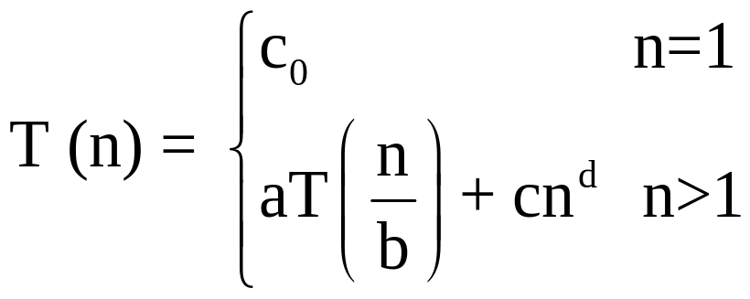
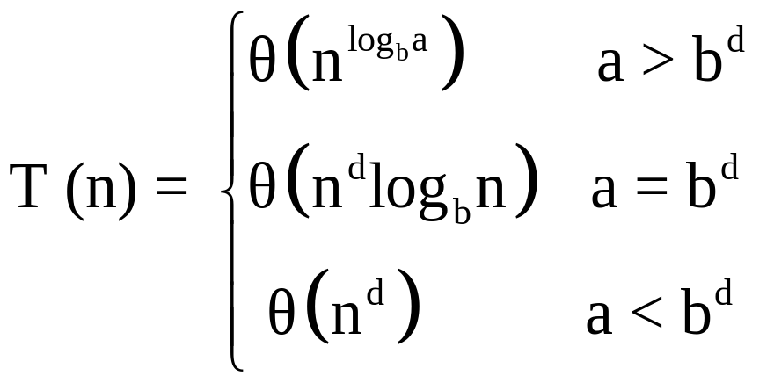
A Useful Theorem
c > 0, d > 0
If
then

Slide 4
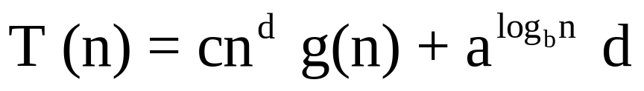
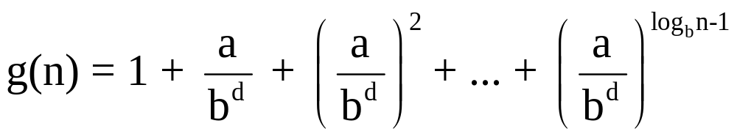
Proof
Is solution

Slide 5
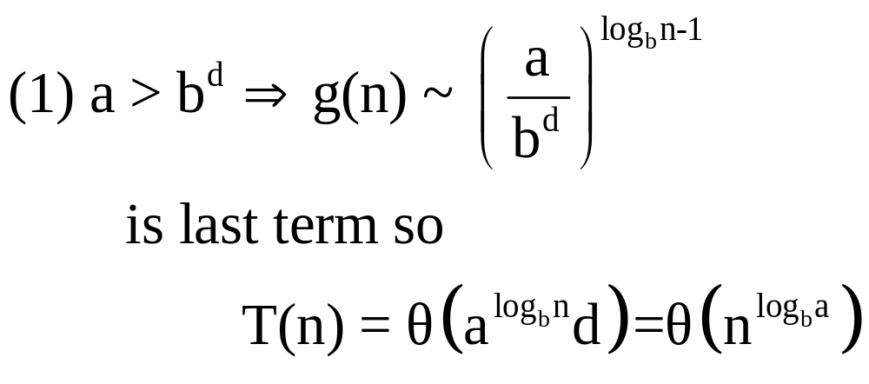
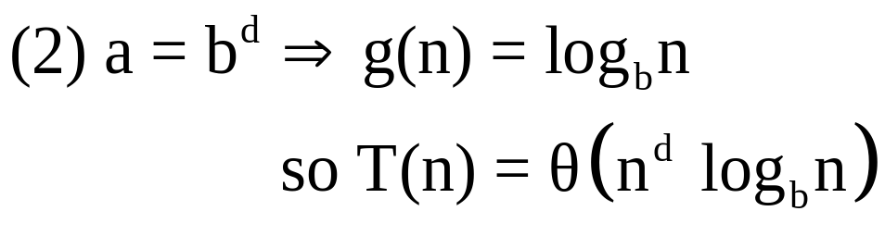
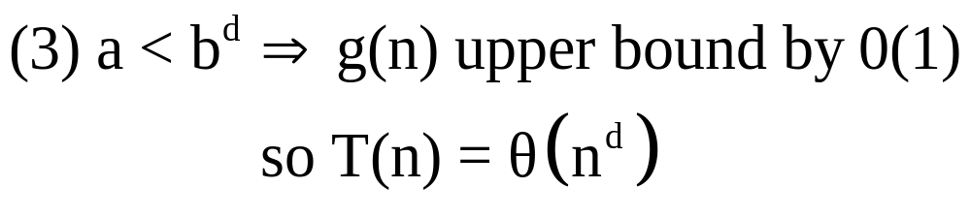
Cases

Slide 6
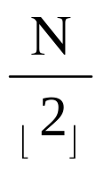
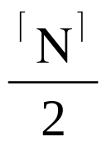
Example: Mergesort
input list L of length N
if N=1 then return L
  else do
  let L₁ be the first elements of L
  let L₂ be the last elements of L
  M₁ ← Mergesort (L₁)
  M₂ ← Mergesort (L₂)
  return Merge (M₁ , M₂)

Slide 7
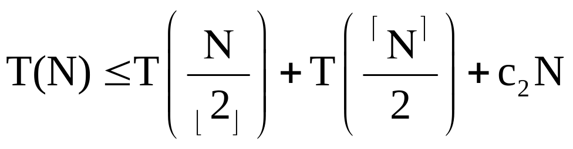
Time Bounds of Mergesort
Initial Value T(1) = c₁
  for N > 1
  for some constants c₁, c₂ > 1

Slide 8
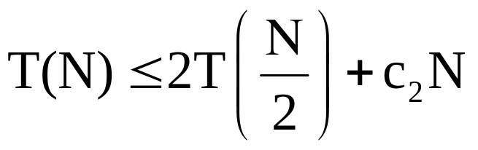
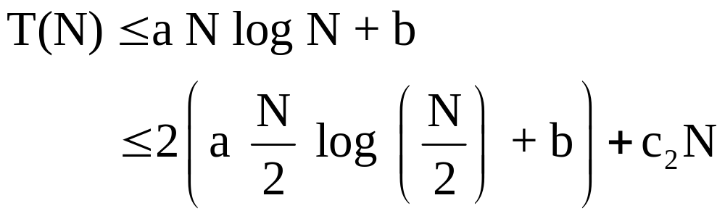
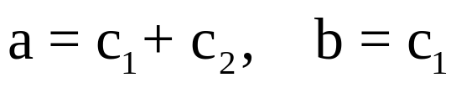
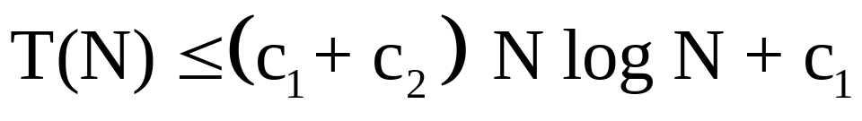
Time Bound (cont’d)
N > 1
guess
Holds if
Solution

Slide 9
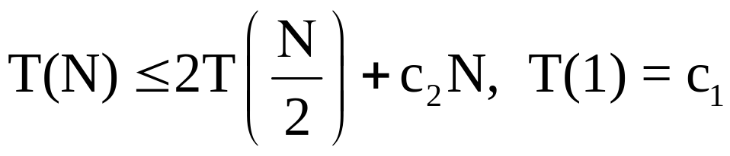
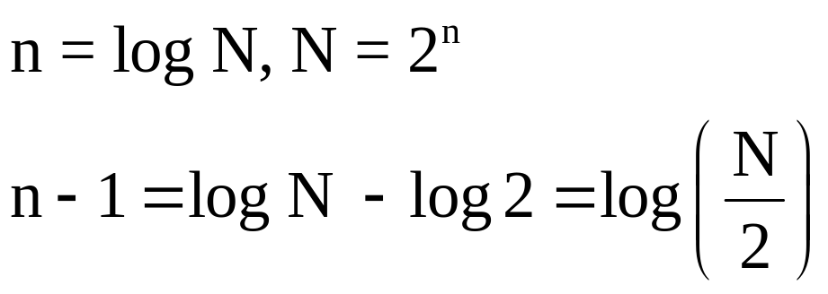
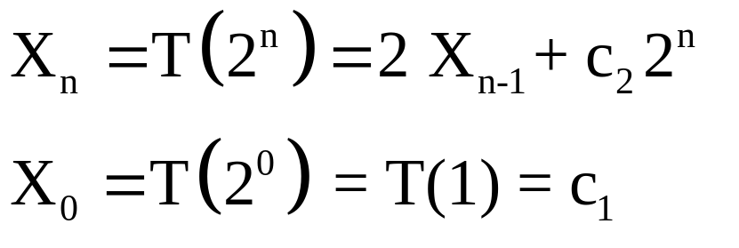
Time Bound (cont’d)
N > 1
Transform Variables
Recurrence equation:

Slide 10
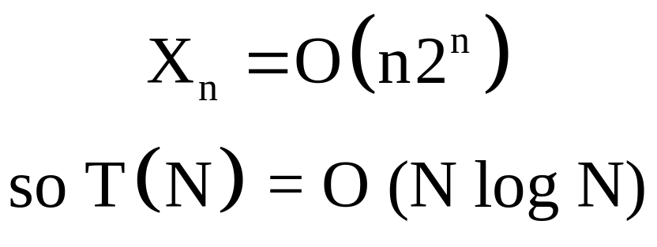
Solve by usual methods for recurrence equations

